Slide 1

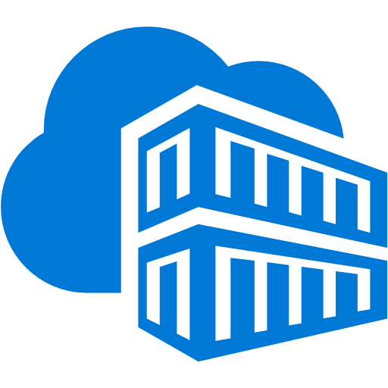





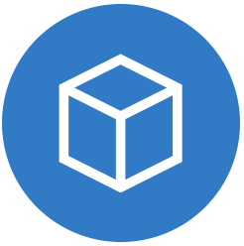

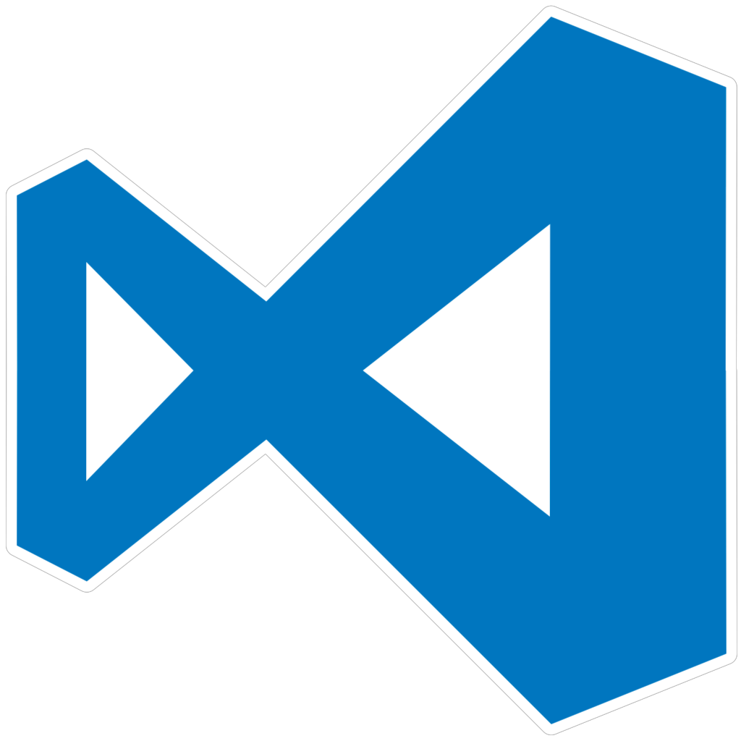
Dev Environment
Legend
Container Registry
Git Repo
Azure DevOps
Infrastructure
Dev Container pipeline
DevOps Pipeline
Databricks Cluster
Dev
Azure Subscription
Build
Dev Container pipeline
Dev Containers
Per Developer User Workspace
Deploy Wheel Package
Execute Jobs
Local PySpark
Databricks Connect
JupyterLab
Databricks Integration
Inner Loop Development
Jupyter Notebook
ETL Package
Local Workspace
Dev Environments
VS Code & Dev Containers
Data Engineers
Dev Container

